Slide 1
Diwali Sales Analysis
Bhagyashree More
Enrollment ID-EN12024077896

Slide 2
Objective
Improve Customer Experience by analyzing sales data
Increase revenue
Data Source link-https://github.com/rishabhnmishra/Python_Diwali_Sales_Analysis/blob/main/Diwali%20Sales%20Data.csv

Slide 3
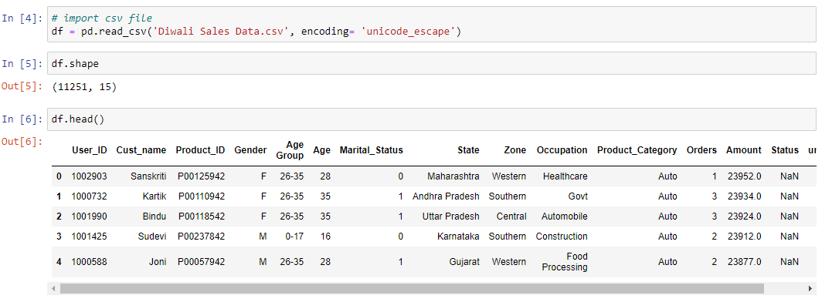
Load Dataset

Slide 4
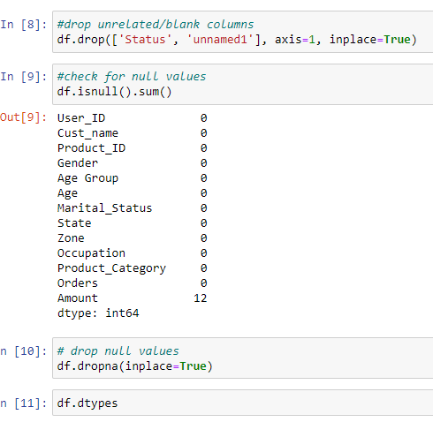
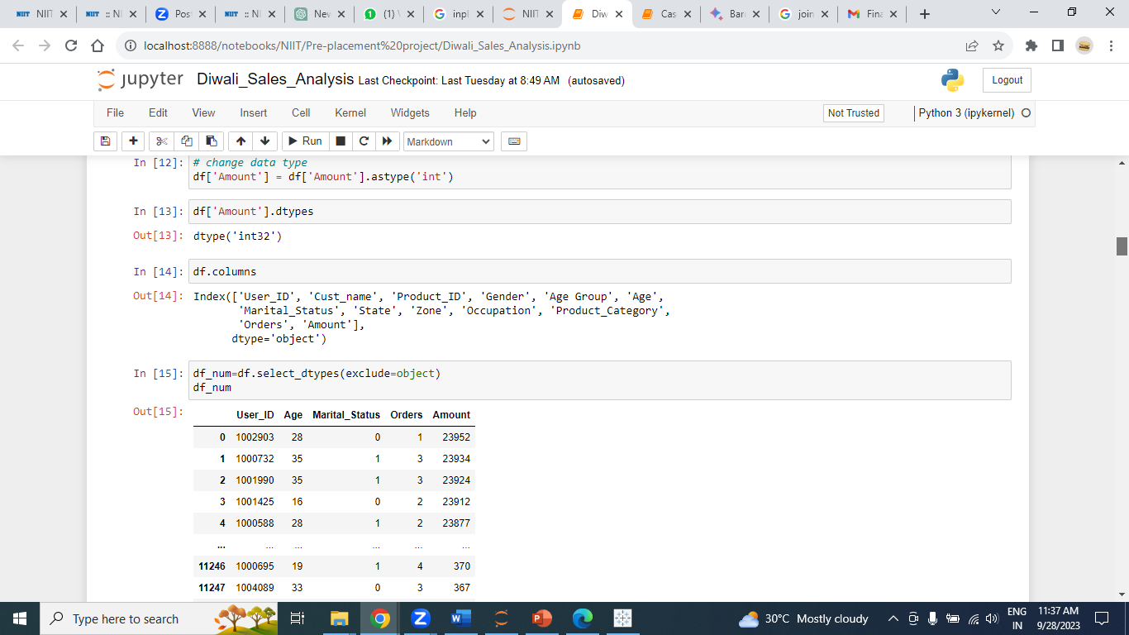
Data Cleaning

Slide 5
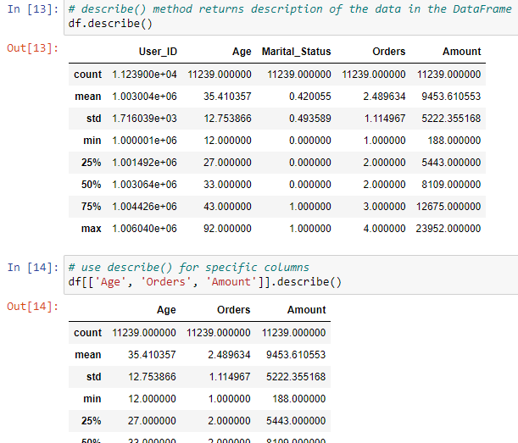
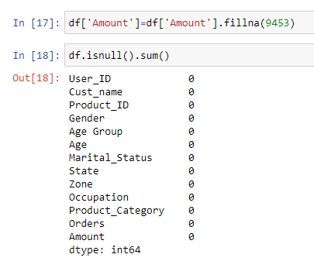
Null Value Treatment

Slide 6
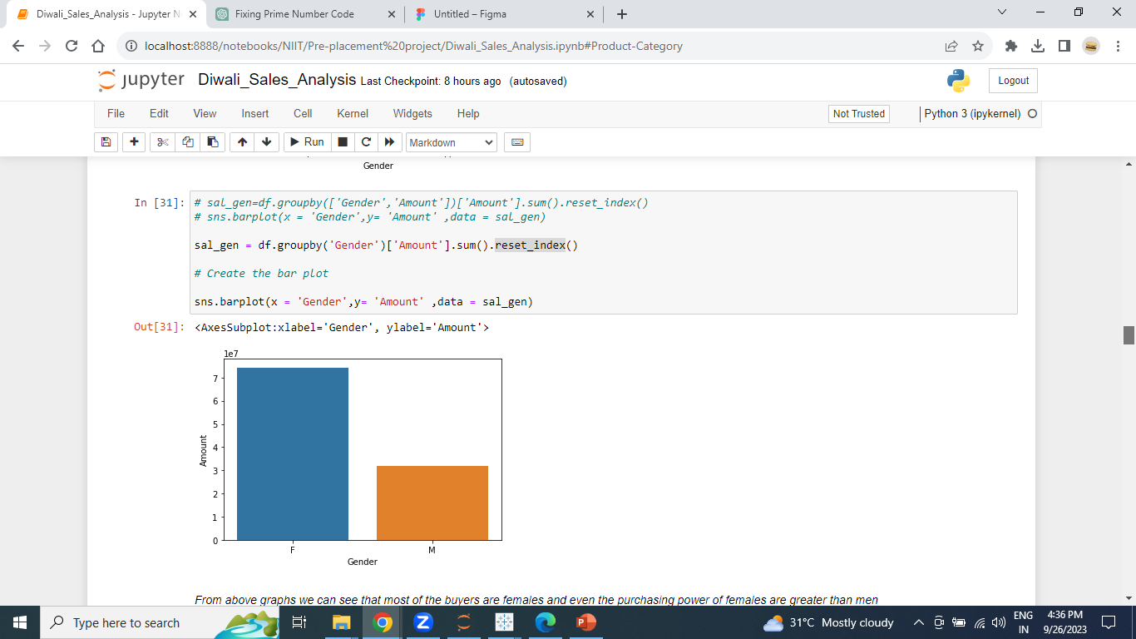
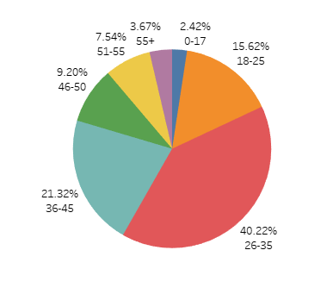
Gender wise spend more money in Diwali sales
From graphs we can see that 70% of the buyers are females and even the purchasing power of females are greater than men

Slide 7
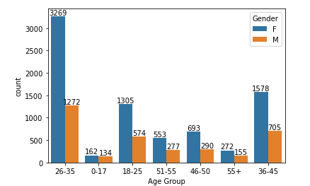
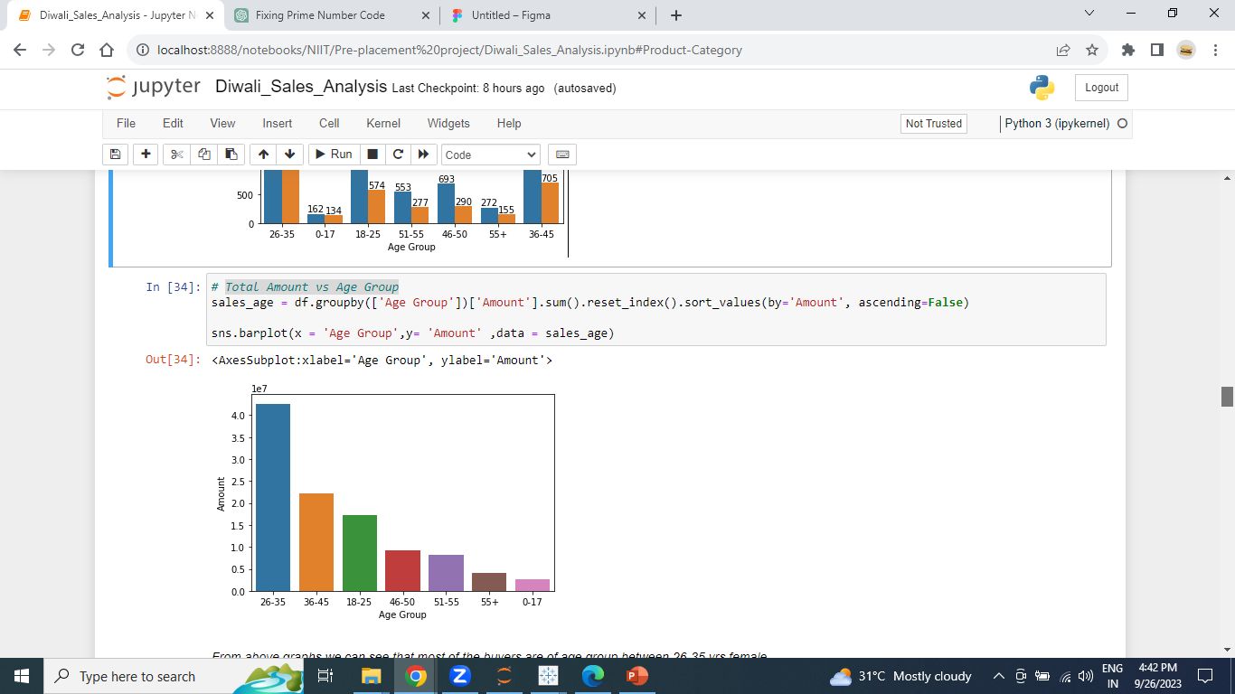
Gender wise & age group wise spend money in Diwali sales
From above graphs we can see that 40% of the buyers are of age group between 26-35 years female

Slide 8
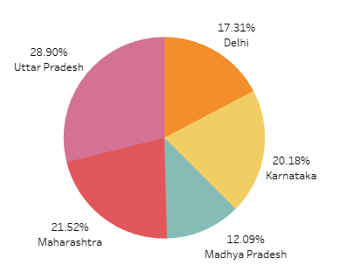
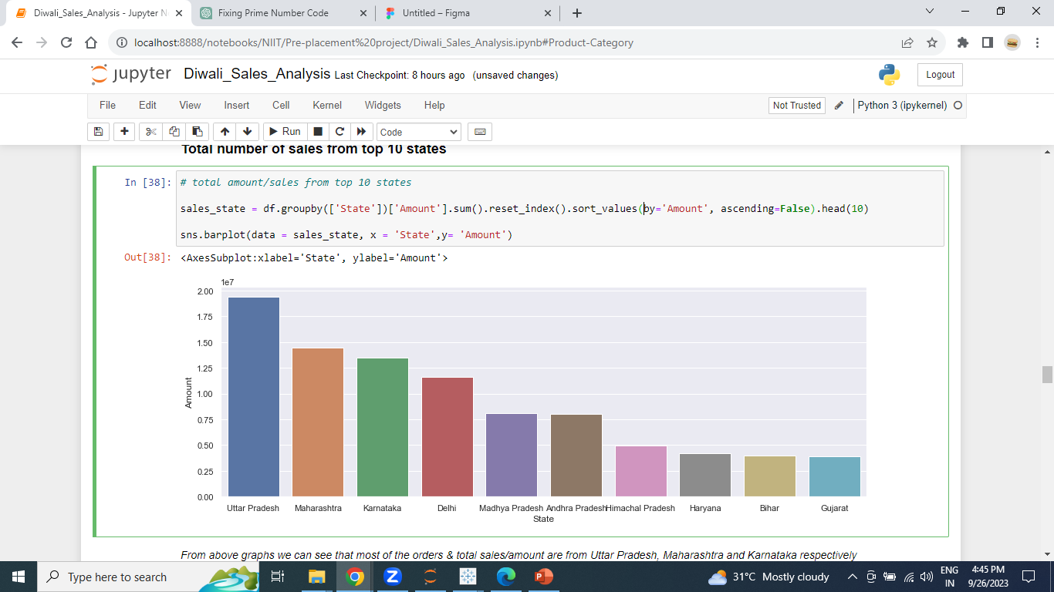
Total amount/sales from top 10 states
From graphs we can see that most of the orders & total sales/amount are from Uttar Pradesh have 30% , Maharashtra have 22% and Karnataka have 20% revenue generated respectively.

Slide 9
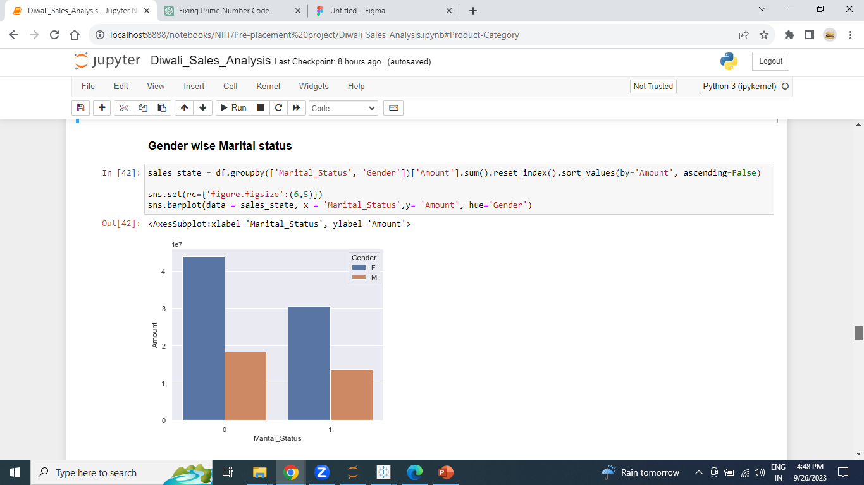
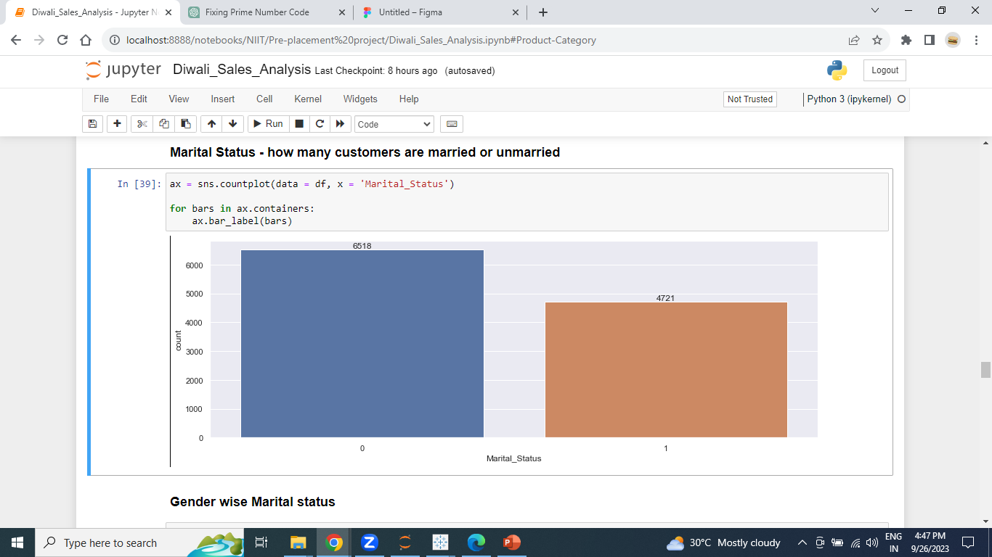
how many customers are married or unmarried?
From above graphs we can see that 65% buyers are married and 45% are women and they have high purchasing power and 35% buyers are not married 27% are women.

Slide 10
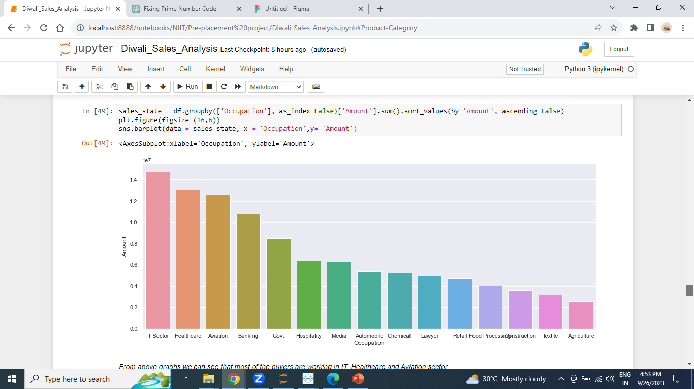
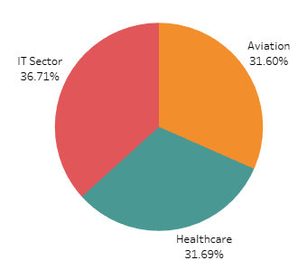
Occupation wise Sales
*37% revenue generated from IT, 32% revenue generated from Healthcare and 31% revenue generated from Aviation sector*

Slide 11
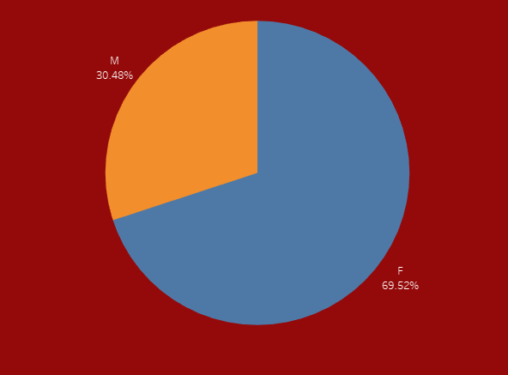
Gender wise shopping in % form
70% of women shopping more in Diwali sales

Slide 12
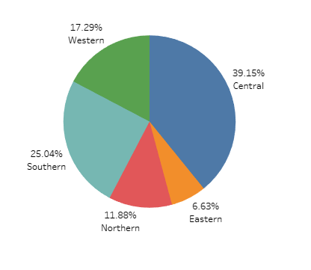
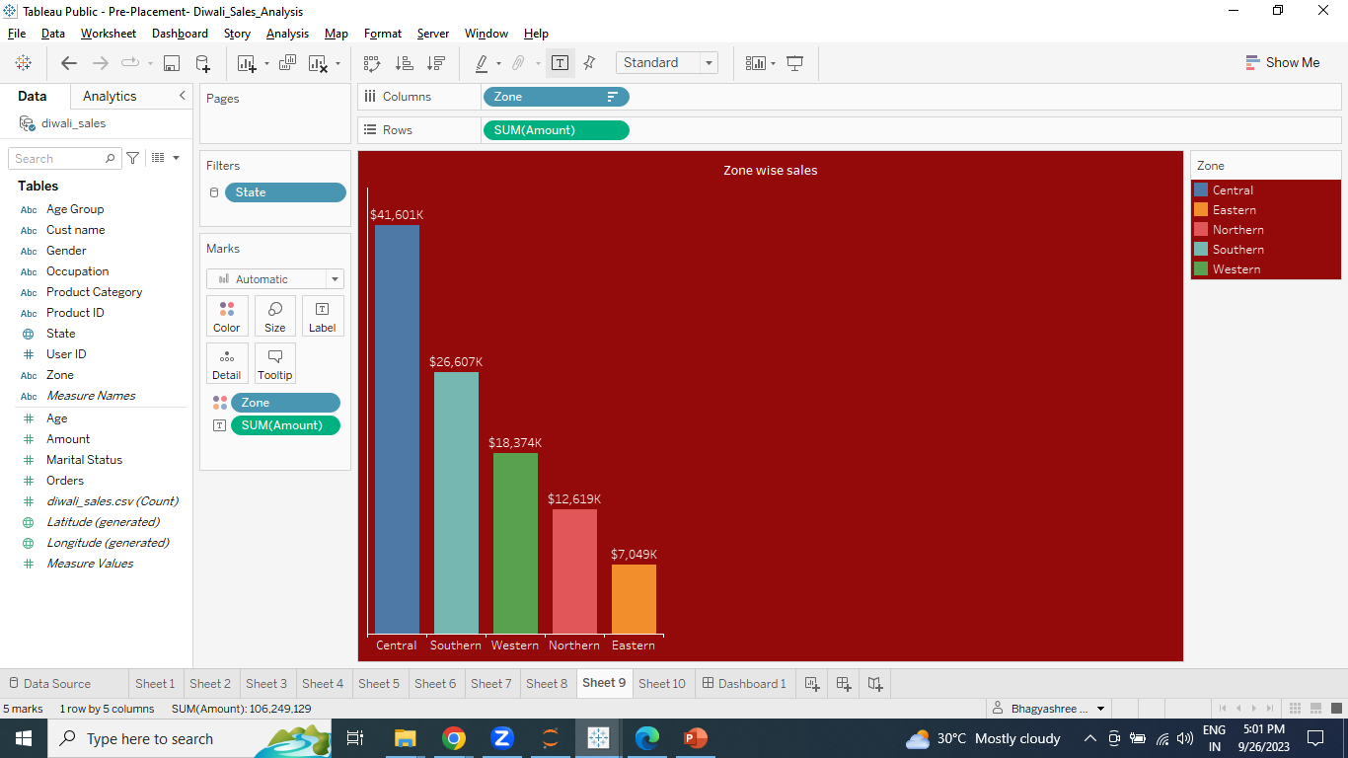
Zone wise Sales
40% of revenue generated by Central zone and 25% of revenue generated by Southern zone

Slide 13
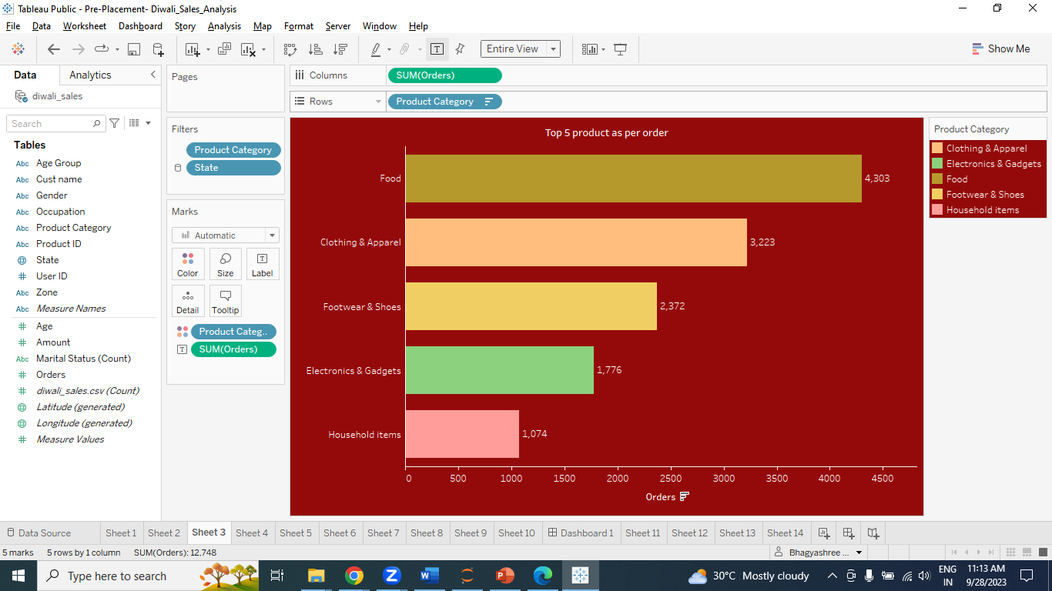
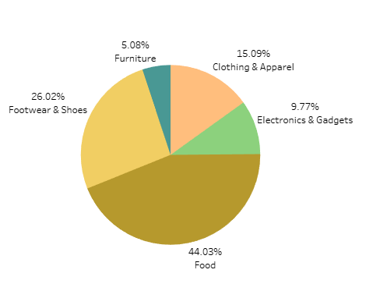
Product category wise sales
44% of products are sold from Food, 15% from Clothing and 10% from Electronics category

Slide 14
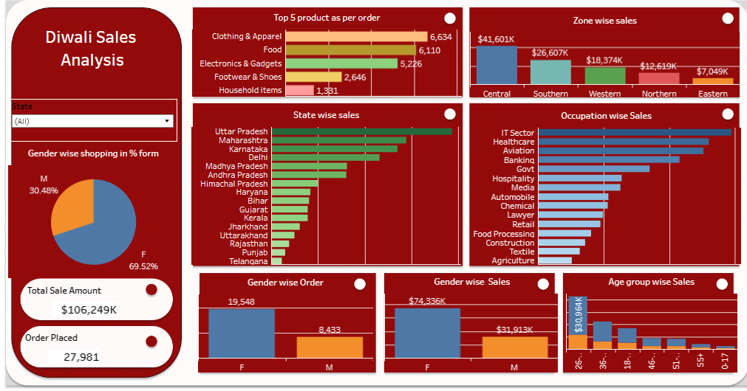

Slide 15
Conclusion
1. 70% of buyers are females and even the purchasing power of females are greater than men.
2. 40% of the buyers are of age group between 26-35 yrs. female
3. From graphs we can see that most of the orders & total sales/amount are from Uttar Pradesh have 30% , Maharashtra have 22% and Karnataka have 20% revenue generated respectively.
4. 65% buyers are married and 45% are women and they have high purchasing power and 35% buyers are not married 27% are women.
5.37% revenue generated from IT, 32% revenue generated from Healthcare and 31% revenue generated from Aviation sector.
6. 44% of products are sold from Food, 15% from Clothing and 10% from Electronics category.
7. 40% of revenue generated by Central zone and 25% of revenue generated by Southern zone.
8. According to me Married women aged 26-35 from UP, Maharashtra, and Karnataka who work in IT, healthcare, and aviation are more likely to buy food, clothing, and electronics. To increase revenue, businesses should focus on this group by marketing to them and making it easy for them to buy.

Slide 16
A strategy for increasing revenue
Target Audience: The focus is on married women in the age group of 26-35 years.
Geographic Focus: The strategy narrows down the geographic focus to the states of Uttar Pradesh (UP), Maharashtra, and Karnataka. This implies that efforts to increase revenue will be concentrated in these regions.
Occupational Focus: The target audience is composed of women working in specific industries, namely IT, Healthcare, and Aviation. This suggests that the products or services being offered are likely to be tailored to the needs or preferences of professionals in these sectors.
Product Categories: The strategy identifies three product categories - Food, Clothing, and Electronics - as the ones that this target demographic is more likely to purchase. This implies that marketing and sales efforts should be directed towards these categories.
In summary, the proposed strategy is to concentrate marketing and sales efforts on married women aged 26-35 years working in IT, Healthcare, and Aviation industries, with a particular focus on the states of UP, Maharashtra, and Karnataka. The products offered should primarily fall into the categories of Food, Clothing, and Electronics to increase revenue from this specific demographic.

Slide 17
Thank You

